Slide 1




R.M.D ENGINEERING COLLEGE
Department of Computer Science and Business Systems
FACE IDENTIFICATION AND CATEGORIZATION
WITH AND WITHOUT MASK
UTILIZING MTCNN AND OPENCV
FOR ACCESSING BANK LOCKER FACILITY
Nikita Devendran, 111520244028.
Deepika LP, 111520244011.
Mounika S, 111520244026.
Ms.R.Monica Lakshmi, B.E, M.E.,
Assistant Professor,
Department of CSBS.

Slide 2
1
ABSTRACT
2
3
Face recognition is a widely used technology with various applications
in security, surveillance, and identity verification systems.
However, the emergence of face masks, particularly during the COVID-19 pandemic, poses a challenge to accurate face recognition.
This project focuses on developing a face recognition system using MTCNN, Facenet, and OpenCV, capable of detecting faces and recognizing individuals even when they are wearing masks.
When the face is verified, they will be allowed to access the
locker. Else, access would be denied.
4
5
6
7
8
9
10

Slide 3
1
OBJECTIVE
2
3
Face recognition technology has gained significant importance in various domains, including security, surveillance, and identity verification systems.
However, the widespread use of face masks, particularly during the COVID-19 pandemic, has posed challenges to accurate face recognition. Masks obscure critical facial features, making it difficult for traditional face recognition systems to perform effectively.
The aim of this project is to develop a face recognition system using MTCNN, Facenet, and OpenCV that can accurately detect and recognize individuals even when they are wearing masks and then enable respective access to the bank lockers.
4
5
6
7
8
9
10

Slide 4
EXISTING SYSTEM AND
ITS DISADVANTAGES
1
2
3
Traditional face recognition algorithms heavily rely on facial features, such as the nose, mouth, and chin. As a result, the performance of existing face recognition systems significantly deteriorates in scenarios where mask usage is prevalent.
To overcome this limitation, some approaches have been proposed, such as using face
alignment techniques to estimate the position of facial landmarks under the mask or employing
face reconstruction methods to recover the occluded facial regions. However, these techniques
often require additional computational resources and may not yield satisfactory results.
The disadvantages are :
4
5
6
7
8
Computational Complexity
Privacy Concerns
Dependence on Other Biometrics
Reduced Accuracy
Increased False Matches
Mask Detection Limitations
9
10

Slide 5
1
PROPOSED SYSTEM AND
ITS ADVANTAGES
2
3
The proposed system is a face recognition system incorporates mask detection to enhance accuracy in scenarios where individuals are wearing masks.
The process begins with the use of face detection algorithms like MTCNN to detect and localize faces within the stream. Once the faces are detected, an alignment process is employed to normalize the orientation and scale of each detected face. Then, feature extraction using a deep learning model such as Facenet is done. This model transforms each aligned face into a high-dimensional vector representation called an embedding. Finally, a classifier, often implemented as a softmax classifier and cosine similarity can be utilized to measure the similarity between embedded vectors, enabling face identification.
The advantages are :
4
5
6
7
8
Improved Accuracy.
Enhanced Security.
Contactless Interaction.
User Convenience.
Public Health Compliance.
Robustness and Flexibility.
9
10

Slide 6
1
SYSTEM SPECIFICATION
2
SOFTWARE :
An x64-based processor.
Anaconda Distributor.
Python - 3.7 or later versions.
HARDWARE :
4 GB of RAM.
80 GB of hard disk capacity.
15 inch color monitor.
3
Visual Studio Code.
Windows 7 or later versions. (64 bit)
Text editor such as Notepad, MS Word.
4
5
6
7
8
52x CD-ROM drive.
Full HD webcam.
Core i3 processor and above.
9
10

Slide 7
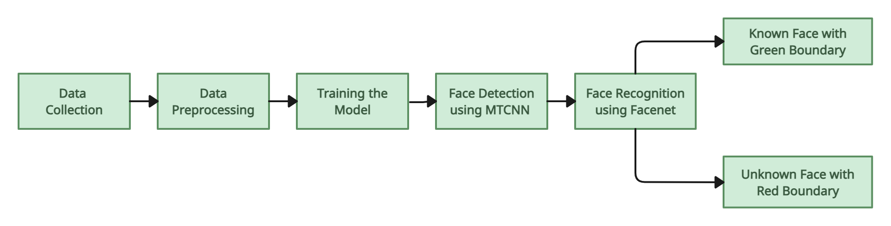
1
2
SYSTEM ARCHITECTURE
3
4
5
6
7
8
9
13
10

Slide 8
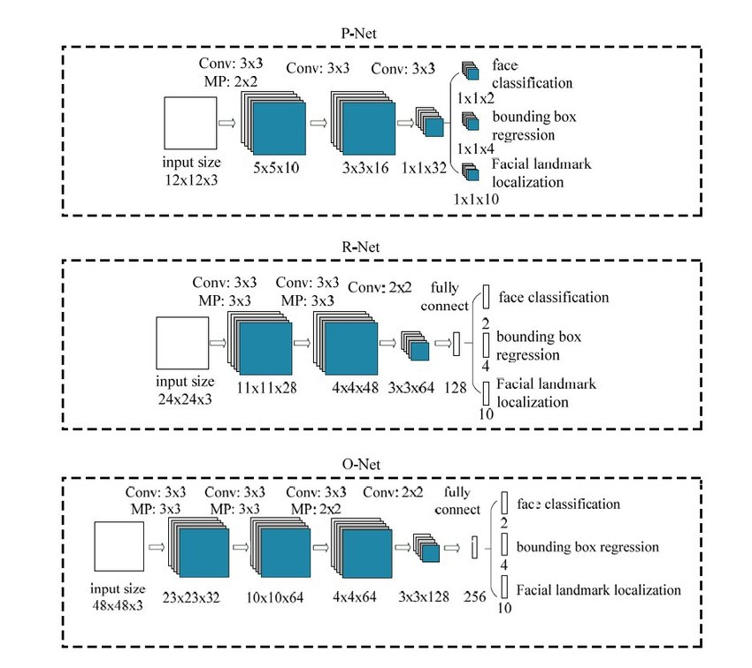
1
FRAMEWORKS EMPLOYED
2
Multi-task Cascaded Convolutional Networks (MTCNN)
It is a face detection algorithm that efficiently detects and localizes faces in images or video frames.
It consists of three stages: face proposal network, bounding box regression network, and facial landmark detection.
PNet (Primary Network): It is responsible for feature extraction.
RNet (Refinement Network): Refines features extracted by the PNet for improved accuracy.
ONet (Output Network): Produces the desired output or prediction based on refined features from previous layers
3
4
5
6
7
8
9
10

Slide 9
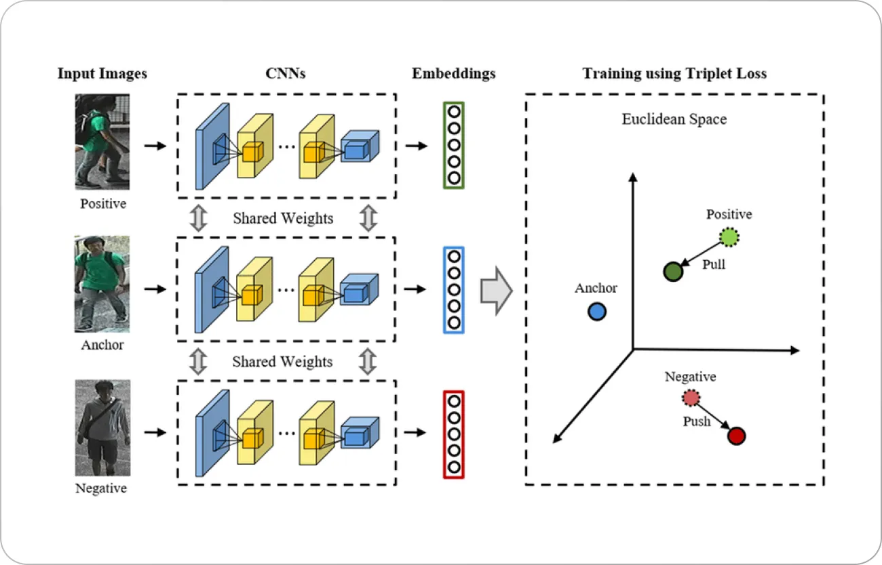
1
FRAMEWORKS EMPLOYED
2
FaceNet
Embedding is a numerical representation of a face extracted from an image.
FaceNet uses embedding to map similar faces together and dissimilar faces further apart.
It uses triplet loss function to compare the similarity of three images : anchor image, positive image, and negative image.
The model is trained to minimize the distance between the embeddings of the anchor and positive images while maximizing the distance between the embeddings of the anchor and negative images.
3
4
5
6
7
8
9
10

Slide 10
1
LIST OF MODULES
2
Data Collection
Utilizing the webcam to gather images of the individual and storing
it in the respective named directory.
Training and Calibration
This module involves two stages namely, image augmentation and
image embedding.
Face Detection
It detects the face using MTCNN which extracts a list of bounding
boxes, coordinates of smallest possible rectangles around faces.
Face Identification
It is done using FaceNet. The embeddings are compared using any
distance metrics to determine the similarity between the extracted features
and the ones in the database.
3
4
5
6
7
8
9
10

Slide 11
1
MODULE 1 : DATA COLLECTION
2
Data collection is a crucial step in developing a face recognition system.
The process involves gathering relevant data to train the face detection, and face recognition algorithms.
Collect a diverse dataset of face images representing different individuals. These images should cover variations in age, gender, ethnicity, and facial expressions.
The images are collected using the webcam. Position the subject clearly in front of the camera in good lighting to achieve accurate pictures.
This results in the collection of around 100 images by the system. Name the directory with the respective name of the person, this name would be displayed during the identification process.
3
4
5
6
7
8
9
10

Slide 12
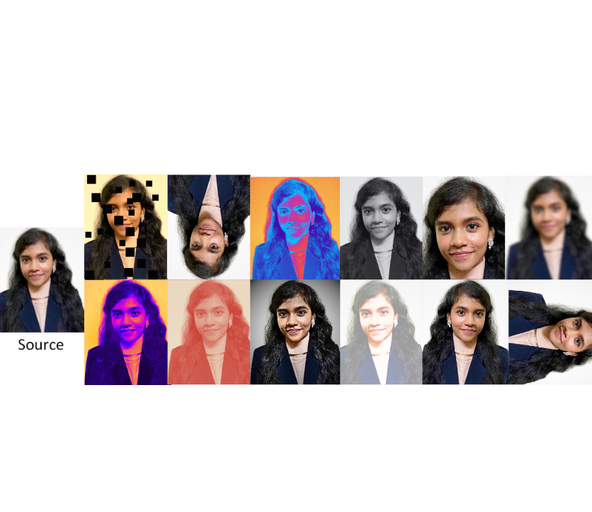
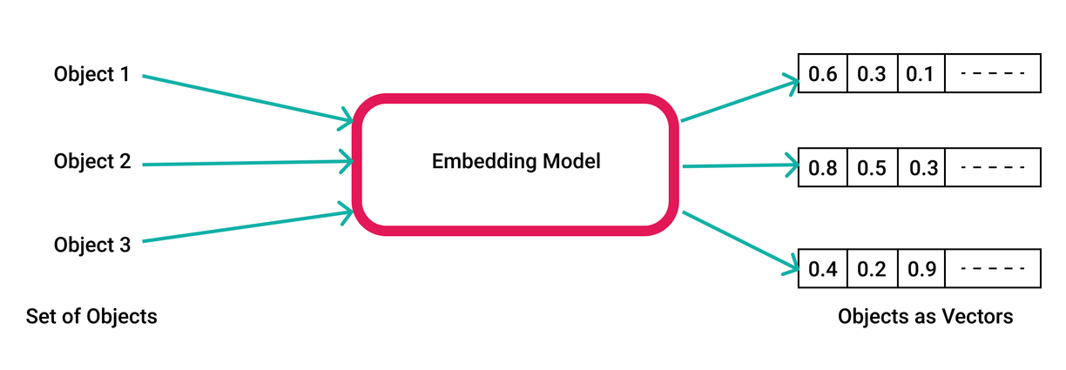
11
MODULE 2 : TRAINING AND CALIBRATION
This module features two stages, namely image augmentation and embedding.
12
13
The goal of image data augmentation is to create new variations of the training images to train the model to become capable of handling different conditions.
When a face recognition system processes an image, it uses a deep learning model to extract features from the face, transforming it into a compact numerical high-dimensional vector representation or embedding.
14
15
16
17
18
19
The above results are used to train the model to identify faces later.
20

Slide 13
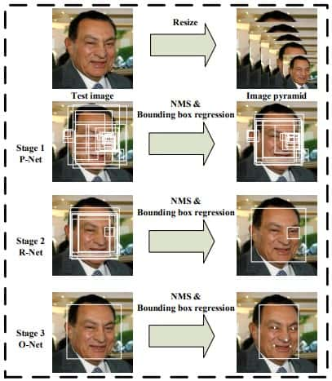
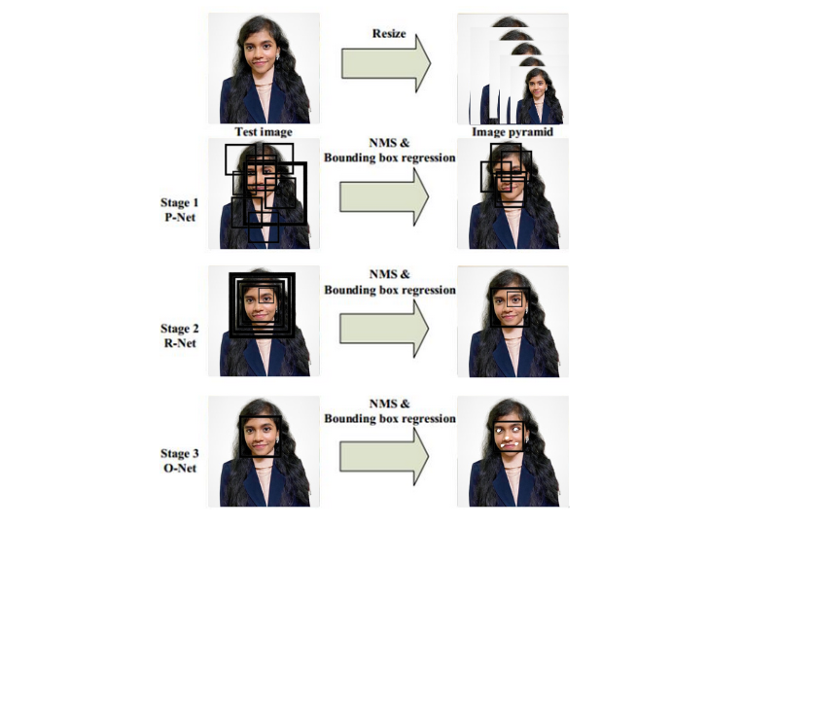
MODULE 3 : FACE DETECTION
11
12
MultiTask Cascaded Convolutional Neural Network is a modern tool for face detection, leveraging a 3-stage neural network detector.
First, the image is resized multiple times to detect faces of different sizes. Then the P-network (Proposal) scans images, performing first detection.
The proposed regions (containing many false positives) are input for the second network, the R-network (Refine), which, as the name suggests, filters detections (also with NMS) to obtain quite precise bounding boxes.
The final stage, the O-network (Output) performs the final refinement of the bounding boxes. This way not only faces are detected, but bounding boxes are very right and precise.
13
14
15
16
17
18
19
20

Slide 14
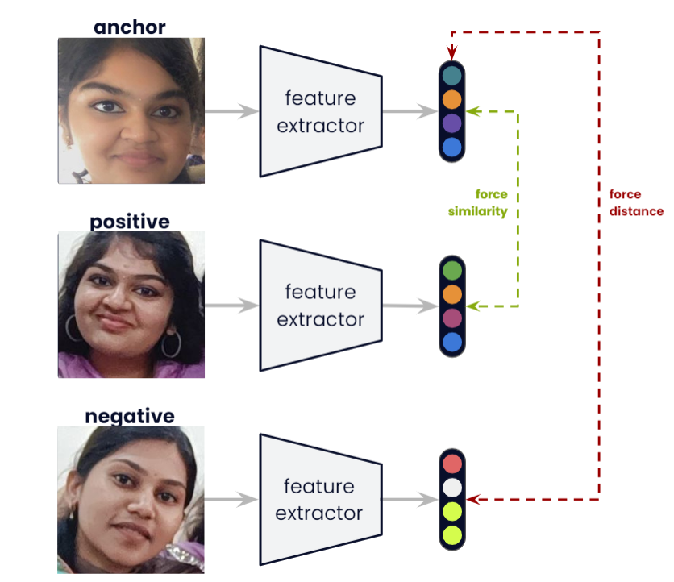
11
MODULE 4 : FACE IDENTIFICATION
12
FaceNet is a facial recognition framework that operates by encoding faces into a high-dimensional vector space, where similar faces are located close to each other.
When a face is detected in an image, FaceNet preprocesses the image and then feeds it into the neural network to generate a numerical representation, known as an embedding, for that face.
These embeddings are then compared using cosine similarity or other distance metrics to determine the similarity between faces.
13
14
15
16
17
18
19
20

Slide 15
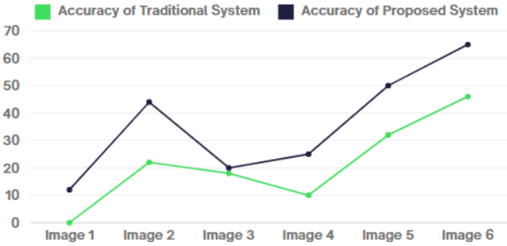
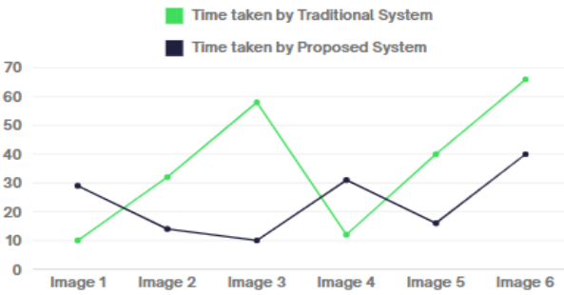
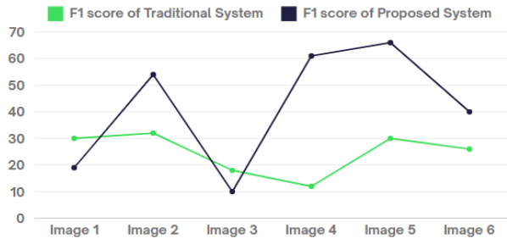
RESULT AND DISCUSSION
11
ACCURACY
Accuracy refers to the ability of the system to correctly identify or verify individuals from their facial features. It is typically measured as the percentage of correct identifications out of the total number of attempts. Without masks, both systems exhibit comparable accuracy levels, but the new system demonstrates its adaptability, effectiveness in the presence of facial coverings.
12
ACCURACY
13
14
ELAPSED DURATION
It refers to the amount of time it takes for the system to process and analyze a given image or video frame to identify faces. When considering the presence of masks, traditional systems struggle to accurately identify individuals, requiring additional steps such as manual verification. In contrast, the new facial recognition systems have adapted to accommodate mask-wearing, effectively reducing the time.
15
TIME
16
17
18
F1 SCORE
F1 score is the harmonic mean of precision (proportion of true positives among all instances classified as positive) and recall (proportion of true positives among all actual positive instances) to evaluate the facial recognition system. The score decreases significantly when individuals wear masks due to occlusion of facial features. With all-new facial recognition systems, the score remains robust even in masked scenarios.
19
F1 SCORE
20

Slide 16
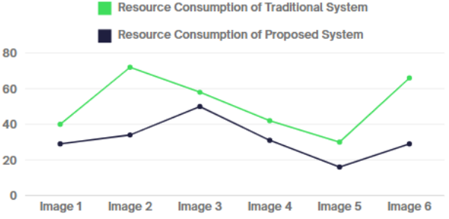
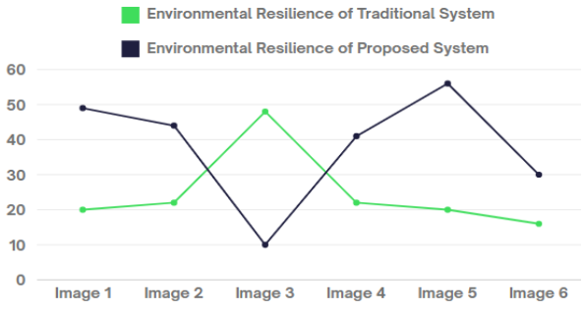
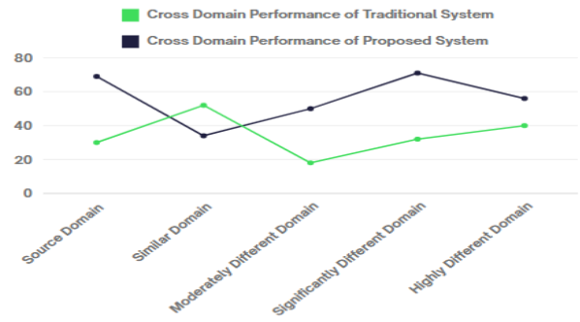
RESULT AND DISCUSSION
11
RESOURCE CONSUMPTION
Resource consumption refers to the amount of computational resources required for the system to operate effectively. Traditional facial recognition systems rely on processing the entire facial structure, consuming considerable computational resources. The proposed facial recognition system equipped with mask detection algorithms can process facial features even when partially covered, thereby reducing computational overhead.
12
13
RESOURCE
CONSUMPTION
14
15
ENVIRONMENTAL RESILIENCE CAPABILITY
It involves the system's capacity to adapt and function effectively despite the environmental variables. Traditional systems struggle in environments where factors like lighting changes or partial obstructions, such as masks are present making them less resilient. The proposed system, especially designed to adapt to these challenges, demonstrates superior environmental resilience.
ENVIRONMENTAL
RESILIENCE
16
17
18
CROSS DOMAIN PERFORMANCE
Cross-domain performance refers to the assessment of a system's effectiveness when deployed across various domains or applications. This evaluation is crucial for understanding how well the system performs in different contexts and scenarios, such as surveillance, access control, or user authentication.This involves assessing its ability to achieve consistent and reliable results across diverse environments, datasets, and plenty of real time use cases.
PERFORMANCE
LEVEL
19
13
20

Slide 17
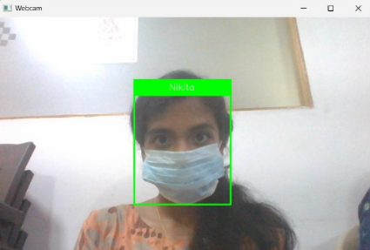
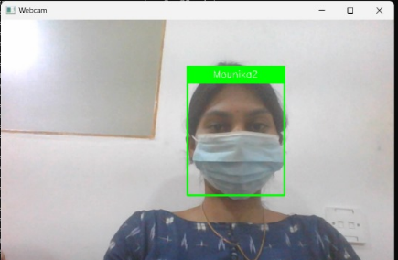
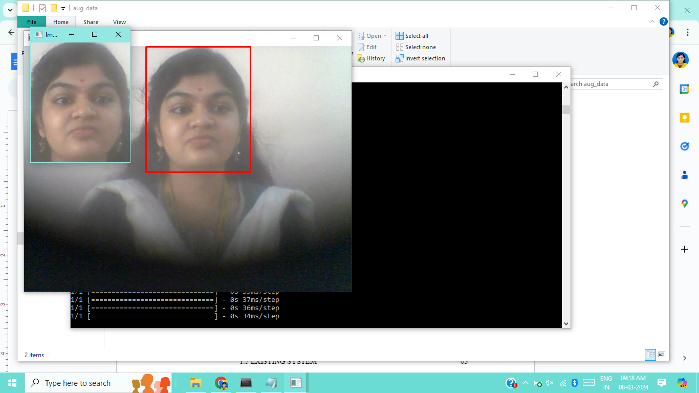
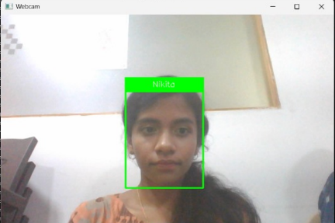
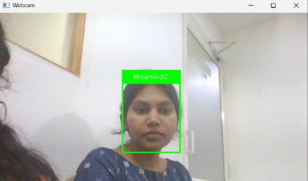
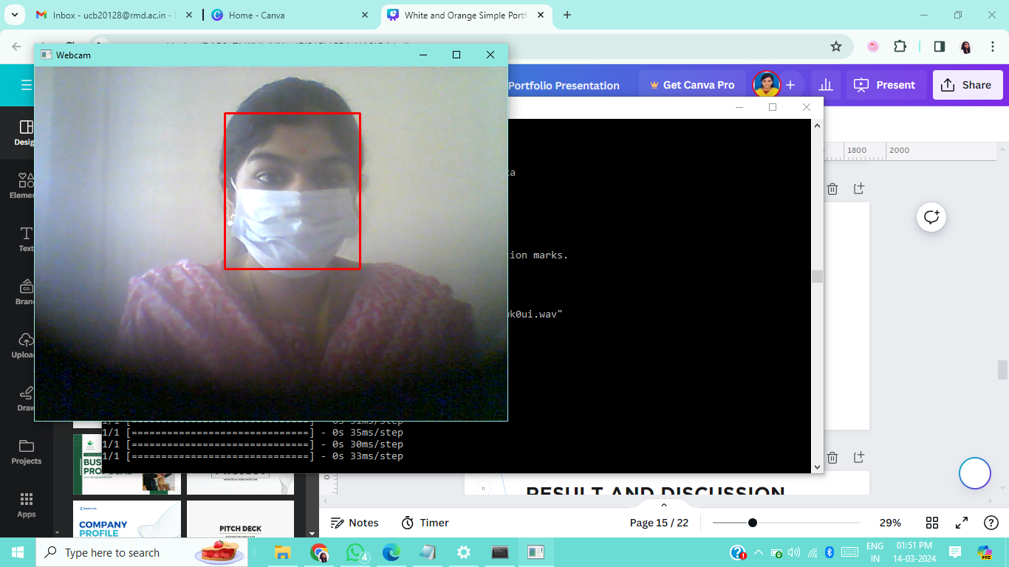
SCREENSHOTS
11
12
13
14
15
16
Fig. Identification of face with mask
Fig. Identification of face with mask
Fig. Untrained Face
17
18
19
20
Fig. Identification of face without mask
Fig. Identification of face without mask
Fig. Untrained Face

Slide 18
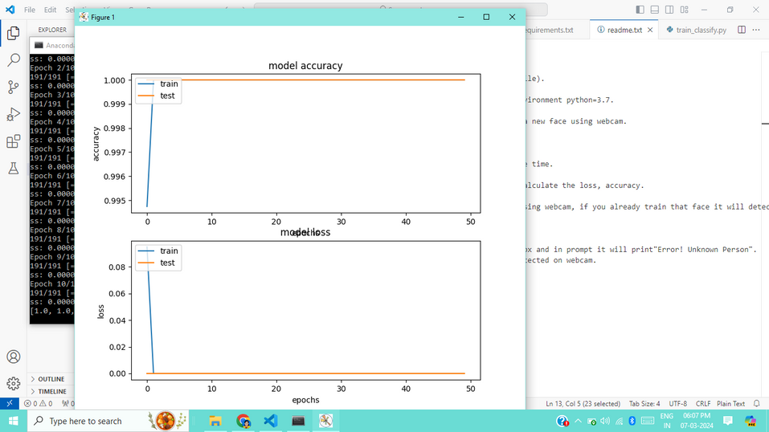
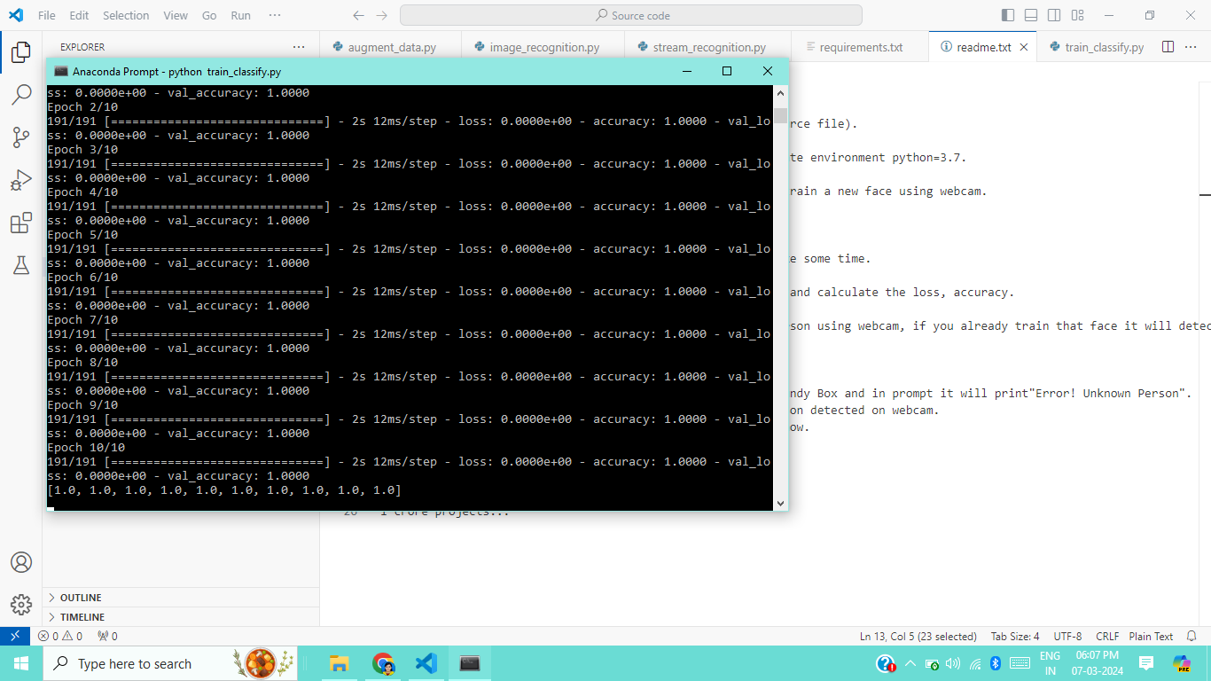
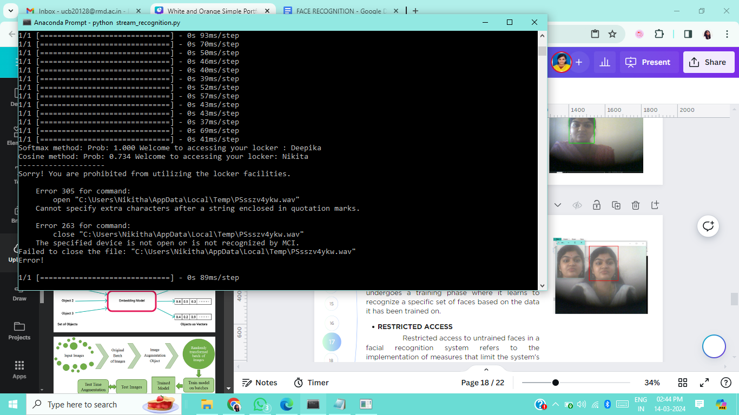
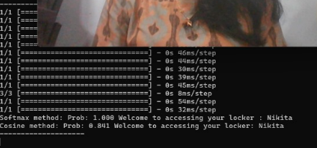
SCREENSHOTS
11
12
13
14
15
16
Fig. Accuracy and Loss Graph Generation
Fig. Accuracy and Loss Epoch Calculation
17
18
19
20
Fig. Restricted Access
Fig. Access Granted with Classification results

Slide 19
11
CONCLUSION
12
13
The face recognition system with mask detection presents a solution to the challenges posed by masks in accurate identification and verification.
By integrating mask detection with face recognition algorithms, the system improves the overall accuracy and reliability of recognizing individuals, even when they are wearing masks.
The proposed system respects privacy considerations and can be customized and adapted to different environments, ensuring its versatility.
Overall, the face recognition system with mask detection using MTCNN, Facenet, and OpenCV is a valuable tool for ensuring accurate and reliable identification, enhancing security measures, and adapting to the challenges presented by masks in today's environment.
14
15
16
17
18
19
20

Slide 20
11
FUTURE ENHANCEMENT
12
Improved Mask Detection : Enhance the accuracy and robustness of the mask detection algorithm by incorporating advanced machine learning techniques, such as deep learning models or ensemble methods.
Multi-Modal Fusion: Investigate the integration of multiple biometric modalities, such as facial features, voice recognition, gait analysis, or even thermal imaging, to further enhance the identification accuracy.
Integration with Bank Locker Access System : Integrate the face identification system with the existing bank locker access control infrastructure, for seamless integration and interoperability.
Real-time Monitoring and Logging: Implement real-time monitoring of individuals entering the bank locker facility, capturing their faces and mask status.
Scalability and Robustness: Ensure that the system is scalable to handle a large number of users and robust enough to perform reliably in real-world conditions.
13
14
15
16
17
18
19
20

Slide 21
REFERENCES
11
[01] G. Singh, I. Gupta, J. Singh and N. Kaur, "Face Recognition using Open Source Computer Vision Library with Python," 10th International Conference on Reliability, Infocom Technologies and Optimization (ICRITO), Noida, India, 2022, pp. 1-6.
[02] A. Kumari Sirivarshitha, K. Sravani, K. S. Priya and V. Bhavani, "An approach for Face Detection and Face Recognition using OpenCV and Face Recognition Libraries in Python," 9th International Conference on Advanced Computing and Communication Systems (ICACCS), Coimbatore, India, 2023, pp. 1274-1278.
[03] J. Zhang, "Online Face Recognition System Based on Convolutional Neural Network (CNN)," 2022 3rd International Conference on Computer Science and Management Technology (ICCSMT), Shanghai, China, 2022, pp. 292-295.
[04] D. R. Patel and R. K. Agrawal, "Face Mask Detection and Recognition using OpenCV and Keras," 2020 International Conference on Emerging Trends in Information Technology and Engineering (ic-ETITE), Nagpur, India, 2020, pp. 1-5.
[05] S. Qi, X. Zuo, W. Feng and I. G. Naveen, "Face Recognition Model Based On MTCNN And Facenet," 2022 IEEE 2nd International Conference on Mobile Networks and Wireless Communications (ICMNWC), Tumkur, Karnataka, India, 2022, pp. 1-5.
[06] P. Jain and R. Roy, "Face Recognition with Mask Detection using Deep Learning and OpenCV”, 2021 5th International Conference on Trends in Electronics and Informatics (ICOEI), Tirunelveli, India, 2021, pp. 442-446.
[07] Khan, Soumya & Sengupta, Diganta & Ghosh, Anupam & Chaudhuri, Atal, “MTCNN++: A CNN-based face detection algorithm inspired by MTCNN” , 2023, pp. 1-19.
[08] Wang Xiang, “The Research and Analysis of Different Face Recognition Algorithms”, The International Conference on Computing Innovation and Applied Physics (CONF-CIAP), 2022, vol. 2386.
[09] Sun Y, Ren Z, Zheng W., “Research on Face Recognition Algorithms on Image Processing” , Comput Intell Neurosci, 2022.
[10] L. Li, X. Mu, S. Li and H. Peng, "A Review of Face Recognition Technology", in IEEE Access, vol. 8, pp. 139110-139120, 2020.
[11] G. Singh and A. K. Goel, "Face Detection and Recognition System using Digital Image Processing," 2nd International Conference on Innovative Mechanisms for Industry Applications (ICIMIA), Bangalore, India, 2020, pp. 348-352.
[12] P. J. Thilaga, B. A. Khan, A. A. Jones and N. K. Kumar, "Modern Face Recognition with Deep Learning", Second International Conference on Inventive Communication and Computational Technologies (ICICCT), Coimbatore, India, 2021, pp. 1947-1951.
[13] M. Jha, A. Tiwari, M. Himansh and V. M. Manikandan, "Face Recognition: Recent Advancements and Research Challenges," 13th International Conference on Computing Communication and Networking Technologies (ICCCNT), Kharagpur, India, 2022, pp. 1-6 .
[14] R. Sharma, V. K. Sharma and A. Singh, "A Review Paper on Facial Recognition Techniques," 2023 Fifth International Conference on I-SMAC (IoT in Social, Mobile, Analytics and Cloud), Palladam, India, 2021, pp. 617-621.
12
13
14
15
16
17
18
19
20

Slide 22
THANKYOU

